Slide 1



Master of Science HES-SO in Engineering
Orientation : Technologies industrielles (TIN)
Low-complexity scalable IoT framework
Fait par Lucas Bonvin
Sous la direction de
Prof. Dominique Gabioud
Dans l’institut de recherche énergie et environnement de la HES-SO Valais-Wallis
[Expert externe Alain Woeffray, Co-fondateur Des Choses Pareilles]

Slide 2
Low-complexity scalable IoT framework Summary
Introduction
Analysis
Conception
Tests and Results
Conclusion
Notes:
Low scalable … vous dit pas grand-chose -> introduction sur l’IoT

Slide 3
Introduction: The IoT world and cloud.iO 1/2
The Internet of Things
41.6 billions of connected devices by 2025[1]
20.6 Zettabytes of data exchange by 2021[2]
Where does all this data go?
Notes:
1 international data corporation
2 cisco

Slide 4

Introduction: The IoT world and cloud.iO 2/2
Cloud-based frameworks
More than 152 clouds (postcapes.com) + cloud.iO
cloud.iO was created at the HES-SO Valais-Wallis for research projects [3]
Endpoint
Endpoint
Notes:
User possède des Endpoints

Slide 5
Analysis : Specifications
From cloud.iO v0.1 to cloud.iO v0.2
Analysis of the IoT landscape, positioning new cloud.iO v0.2
Collection of requirements for cloud.iO v0.2, elaboration of the specification
Development, documentation, test and validation of cloud.iO v0.2

Slide 6
Analysis: State of the art
What features define an IoT cloud framework?
Thing Monitoring (Digital Twin)
Thing History
History Visualisation
Remote Job Execution
Rules Engine
Cloud Computing

Slide 7
Analysis: State of the art
What features define an IoT cloud framework?
On-premise deployment
Specific Hardware
SDK/API
Edge Computing
Interoperability

Slide 8




Analysis: cloud.iO v0.1 1/2
Spring.io
Micro-service Platform
Open source
RabbitMQ
Message Broker
Support AMQP and MQTT
Open source
MQTT
Messaging protocol
Support TLS/SSL
Authentication using x509 certificate
MongoDB and InfluxDB
Database
Free Software
Two libraries (SDK)
Java
Python

Slide 9
Analysis: cloud.iO v0.1 2/2
Low-complexity: multiple simple services
Scalability: services distributed on multiple computing node
Extensibility: new services easily added
Low-complexity scalable IoT framework

Slide 10
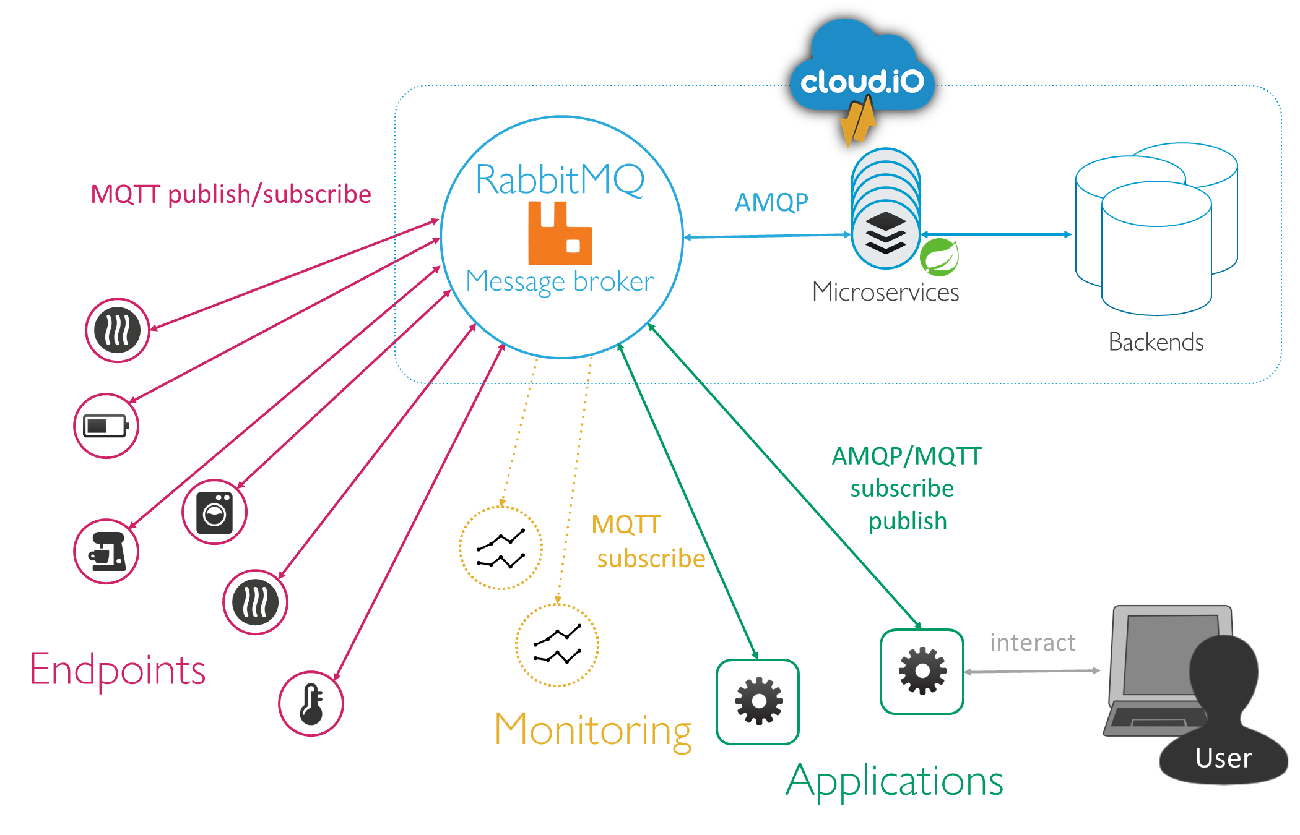
Analysis: cloud.iO v0.1: Architecture
Notes:
Utilisateur possède des endpoints

Slide 11
Analysis: cloud.iO v0.1: Messaging Protocol
Message Broker
Exchanges
Producer
X
publish
Queues
X
route
X
Consumer
X
 | MQTT | AMQP
Simple Topic | example.toto.titi | example/toto/titi
Single Level Wildcard | example.+.titi | example/*/titi
Multi-Level Wildcard | example.# | example.#

Slide 12
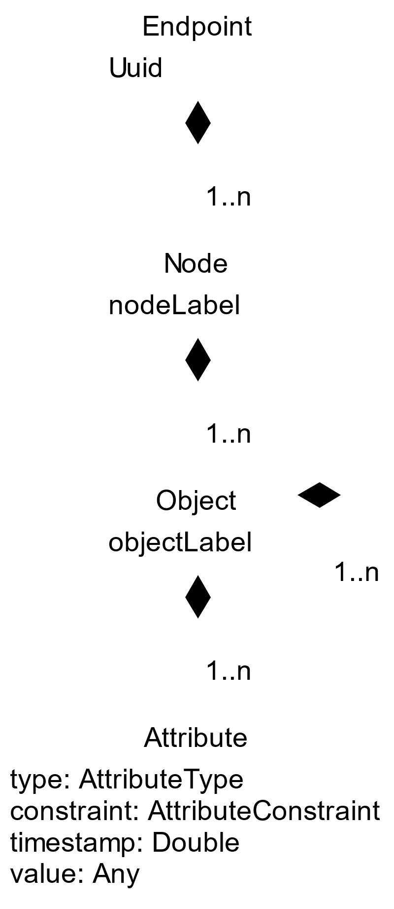
Analysis: cloud.iO v0.1: From Endpoint to Attribute
Attribute Type:
Bool
Integer
Number
String
Attribute Constraint:
Static: Read-only, Static value
Status: Read-only, computed value
Measure: Read-only, represent physical process
Parameter: Read/Write, change the Endpoint’s behavior, persistent
SetPoint: Read/Write, Control value, non-persistent

Slide 13
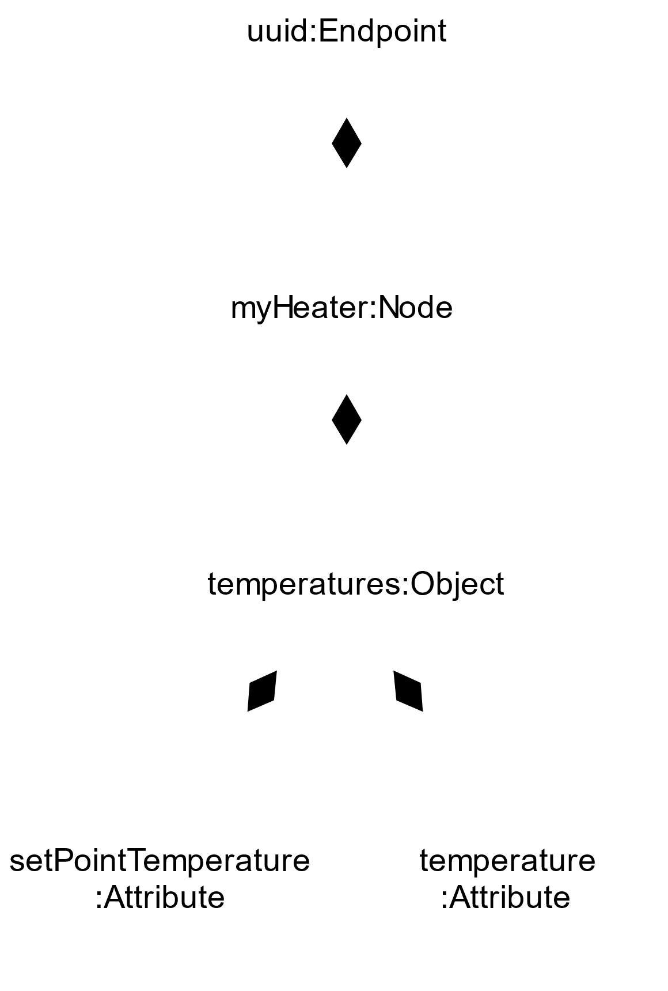
Analysis: cloud.iO v0.1: From Endpoint to Attribute
Attribute Type:
Bool
Integer
Number
String
Attribute Constraint:
Static: Read-only, Static value
Status: Read-only, computed value
Measure: Read-only, represent physical process
Parameter: Read/Write, change the Endpoint’s behavior, persistent
SetPoint: Read/Write, Control value, non-persistent

Slide 14
Analysis: cloud.iO v0.1: From Endpoint to Attribute
@prefix/EndpointUUID/node/nodeName/object/objectName/.../attribute/attributeName
Topic: @update/EndpointUUID//node/myHeater/object/temperatures/attribute/temperature
@update/…/AttributeName
@set/…/AttributeName
@online/EndpointUUID
@offline/EndpointUUID
@nodeAdded/…/ NodeNameToAdd
@nodeRemoved/…/NodeNameToRemove
{
"type": "Number",
"constraint": "Measure",
"timestamp":1575547591859.0,
"value": 25
}
Notes:
Mot clef qui definisse la structure

Slide 15
Analysis: Enhance cloud.iO, feedback from users
Redefine topic & access control
Logging
Update of Endpoint/Node/Object
Certificate creation
log

Slide 16
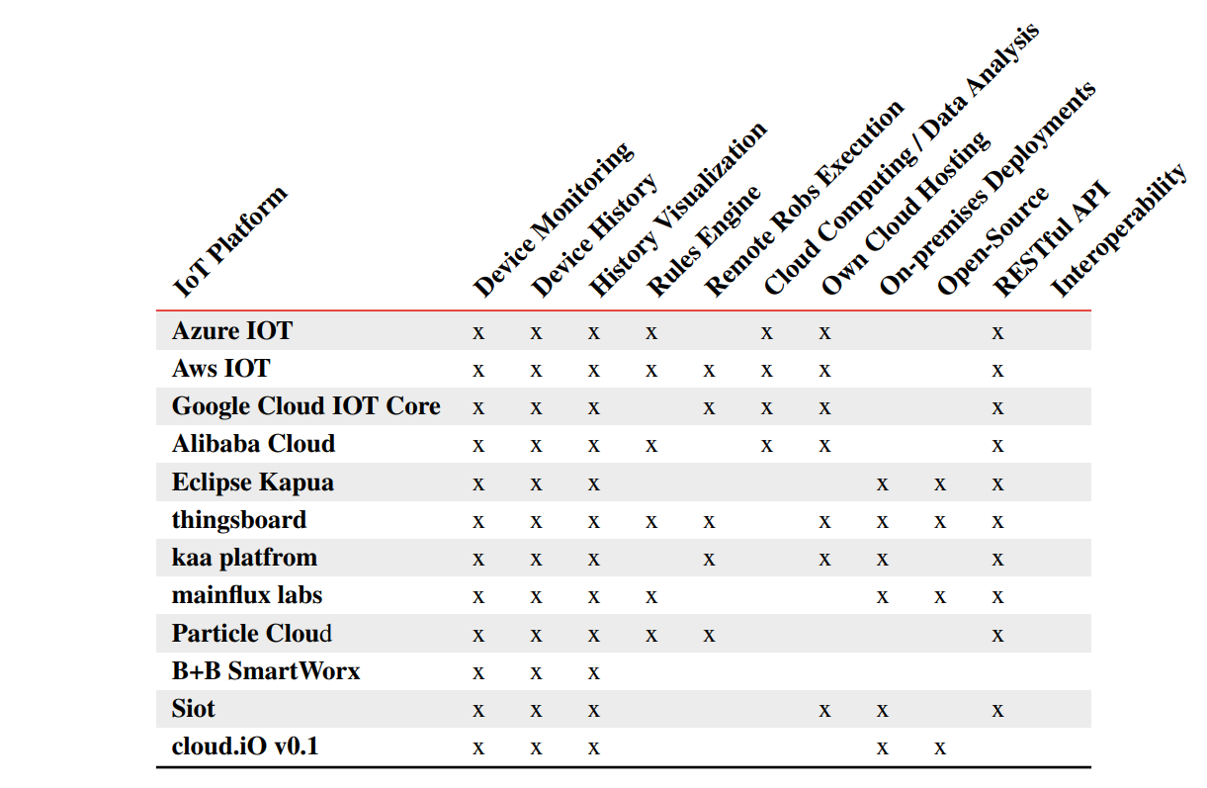
Analysis: Enhance cloud.iO, IoT framework analysis
Notes:
Seul chose à relever: interoperabilité

Slide 17
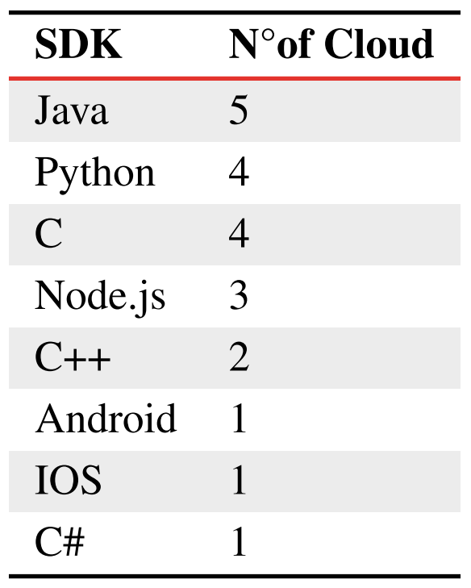
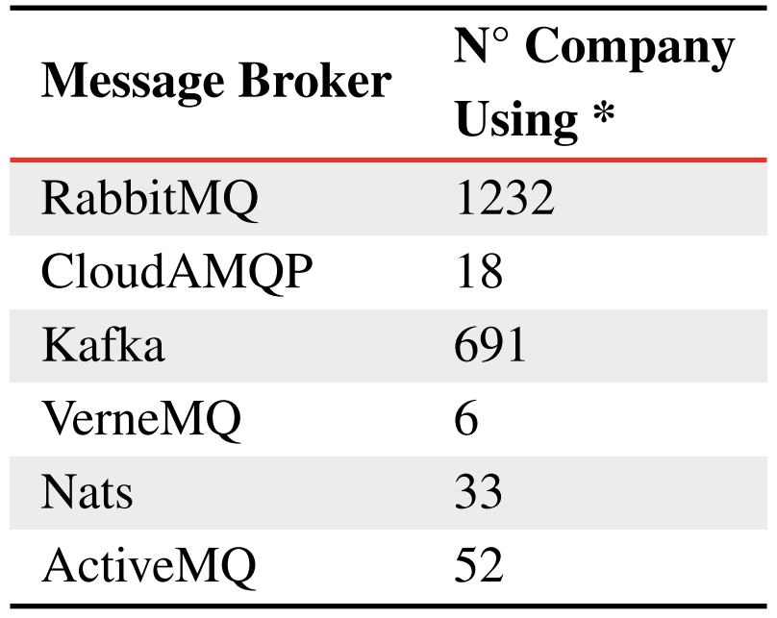
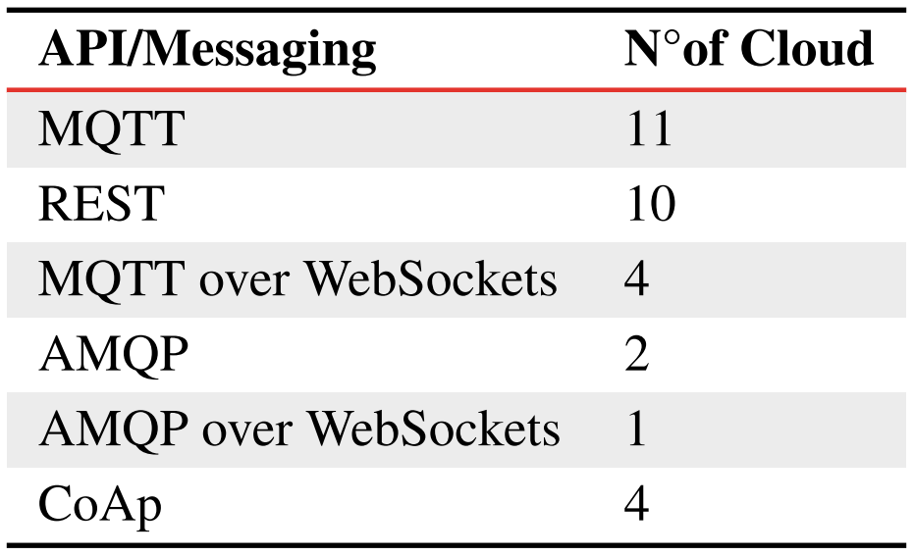
Analysis: Enhance cloud.iO, IoT framework analysis
Notes:
On y reviens durant la synthèse de l’analyse

Slide 18
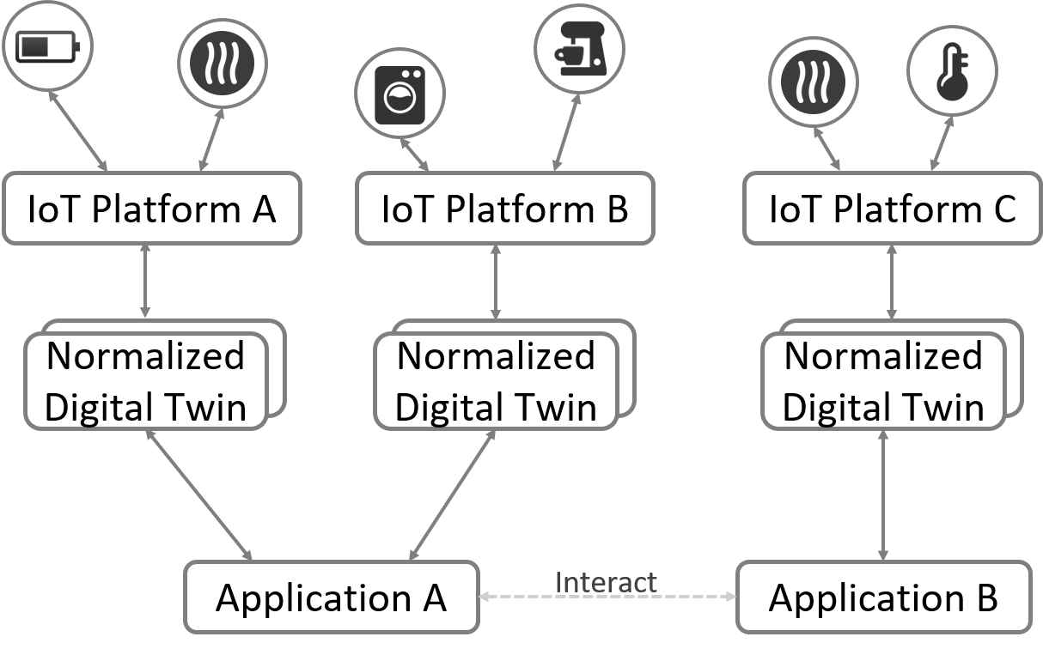
Analysis: Interoperability

Slide 19
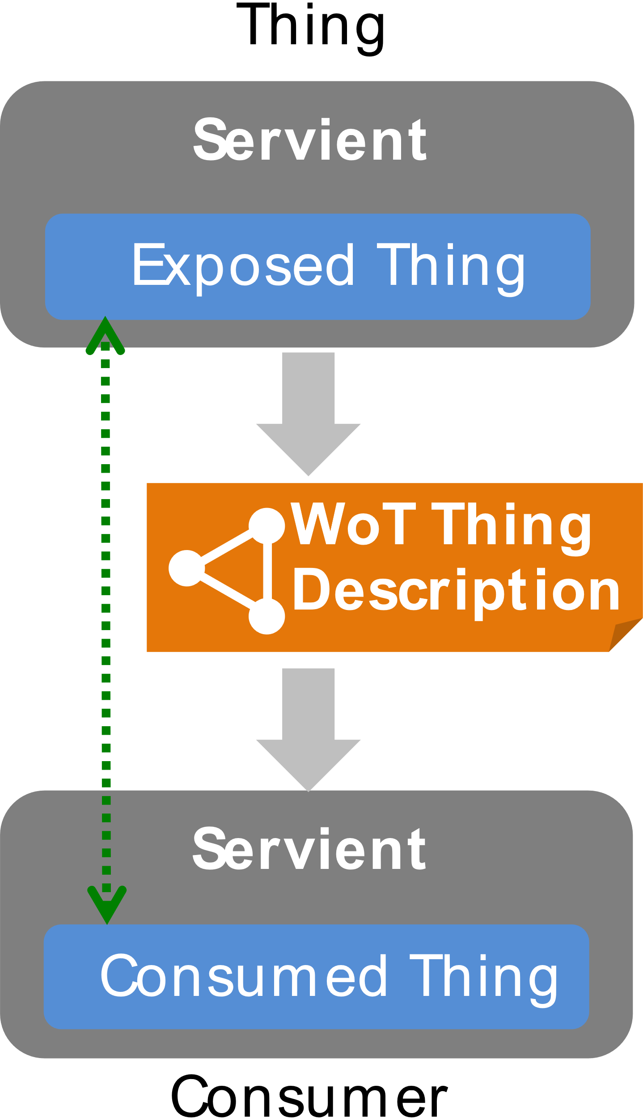
Analysis: Interoperability Web of Thing
World Wide Web Consortium (W3C)
Standardization organism
Behind HTLM, RDF, CSS, PNG, SVG, ...
Standardization of the IoT
Web Of Thing (WoT)
Candidate Recommendation [4][5]
Enhance IoT Interoperability
Define a data model for the Things :TD
TD contain a self-describing API

Slide 20
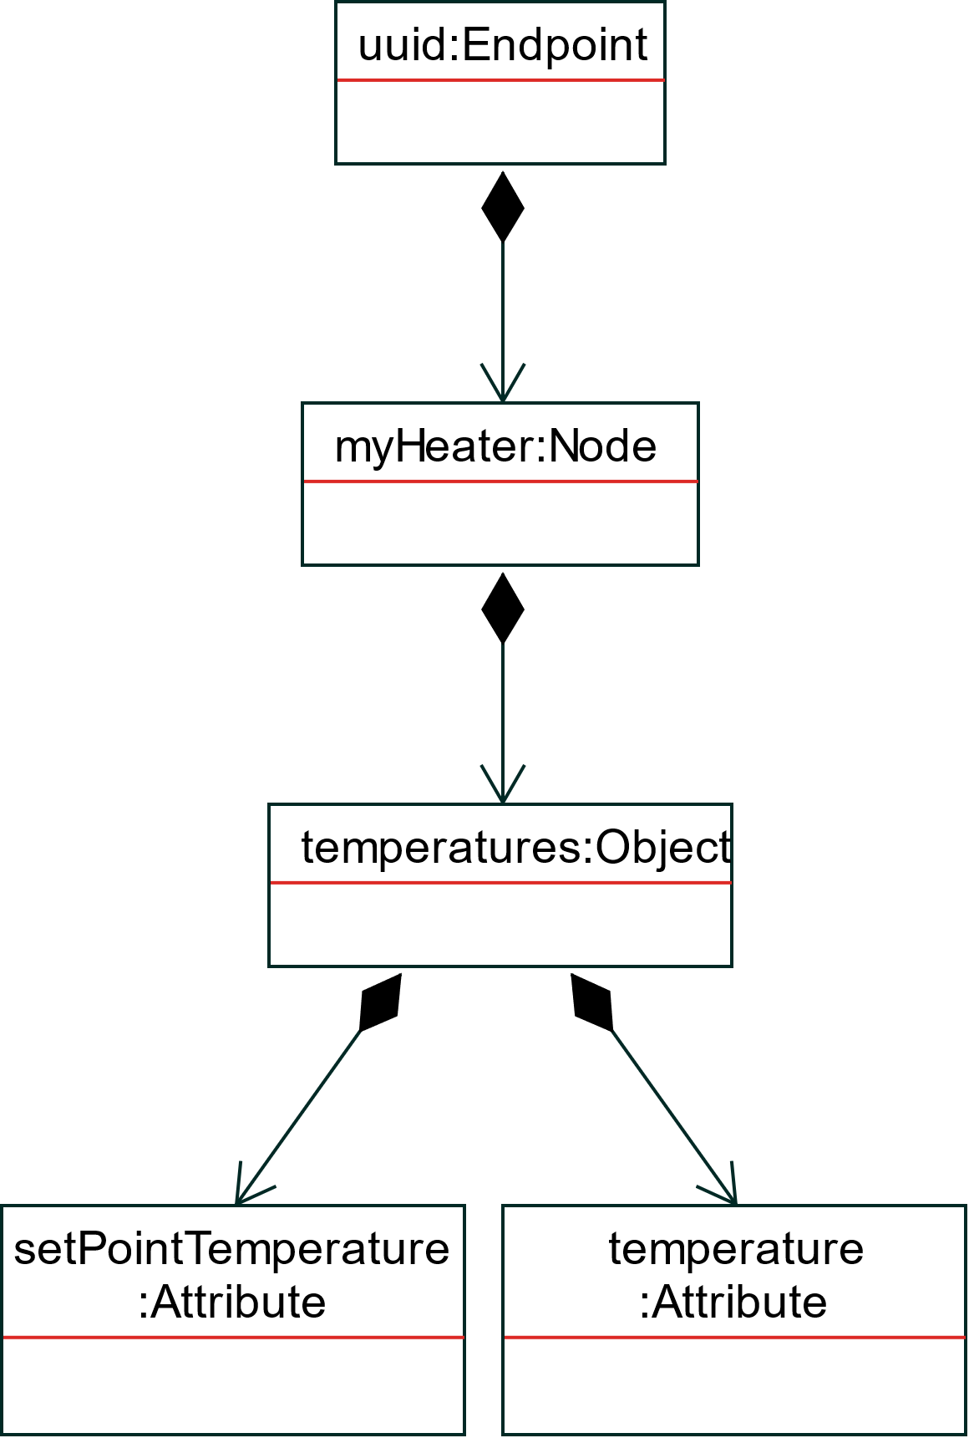
Analysis: Interoperability TD
{
"@context": "https://www.w3.org/2019/wot/td/v1",
"id": "urn:heater",
"title": "myHeater",
"securityDefinitions": {
"basic_sc": {
"scheme": "basic",
"in": "header"
}
},
"security": ["basic_sc"],
"properties": {
"temperature": {
"type": "integer",
"forms": [{"href": "https://myHeater.com/get"}]
},
"setPointTemperature": {
"type": "integer",
"forms": [{"href": "https://myHeater.com/set"}]
}
},
"actions": {
"toggleRegulation": {
"forms": [{"href": "https://myHeater.com/toggle"}]
}
},
"events": {
"temperatureChange": {
"data": {
"type": "integer"
},
"forms": [{"href": "https://myHeater.com/change"}]
}
}
}

Slide 21
Analysis: Interoperability TD
: Meta data
{
"@context": "https://www.w3.org/2019/wot/td/v1",
"id": "urn:heater",
"title": "myHeater",
"securityDefinitions": {
"basic_sc": {
"scheme": "basic",
"in": "header"
}
},
"security": ["basic_sc"],
"properties": {
"temperature": {
"type": "integer",
"forms": [{"href": "https://myHeater.com/get"}]
},
"setPointTemperature": {
"type": "integer",
"forms": [{"href": "https://myHeater.com/set"}]
}
},
"actions": {
"toggleRegulation": {
"forms": [{"href": "https://myHeater.com/toggle"}]
}
},
"events": {
"temperatureChange": {
"data": {
"type": "integer"
},
"forms": [{"href": "https://myHeater.com/change"}]
}
}
}

Slide 22
Analysis: Interoperability TD
: Interaction Affordances
"properties": {
"temperature": {
"type": "integer",
"forms": [{"href": "https://myHeater.com/get"}]
},
"setPointTemperature": {
"type": "integer",
"forms": [{"href": "https://myHeater.com/set"}]
}
},
"actions": {
"toggleRegulation": {
"forms": [{"href": "https://myHeater.com/toggle"}]
}
},
"events": {
"temperatureChange": {
"data": {
"type": "integer"
},
"forms": [{"href": "https://myHeater.com/change"}]
}
}
}

Slide 23
Analysis: Synthesis
From users’ feedback
From cloud analysis
Redefine topic & access control
Logging
Update of Endpoint/Node/ Object
Certificate creation
log
Remote Job Execution
API (RESTful)
Interoperability

Slide 24
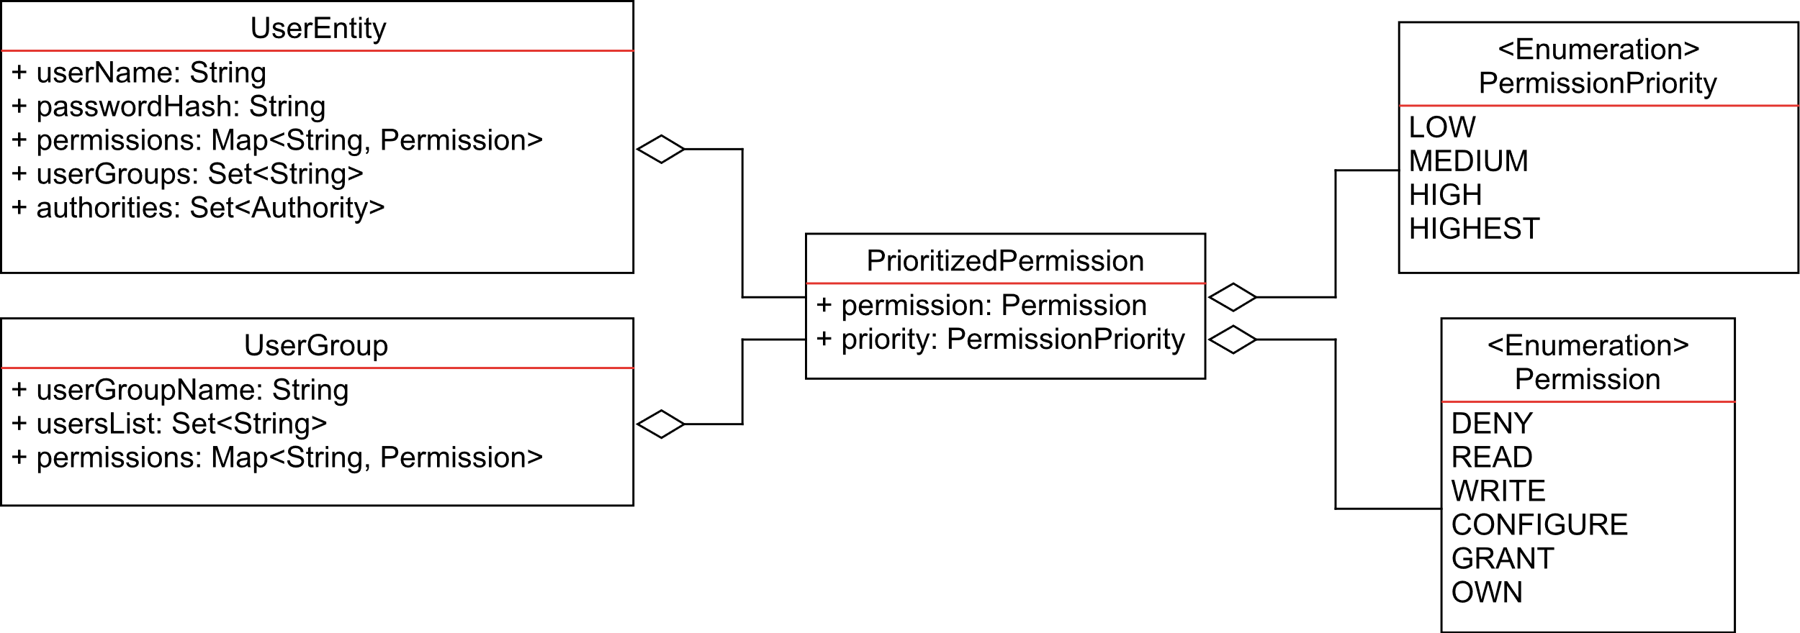
Conception: Topic & Access Control 1/2
@prefix/EndpointUUID/
node/
nodeName/
object/
objectName/
…/
attribute/
attributeName
cloud.iO v0.1
Permission only on Endpoints
cloud.iO v0.2
Access control based on topic
Introduction of prioritized permission
Introduction of user group
Notes:
Structure est fix 1 endpoint, 1 node, 1 ou plus object, 1 attribute

Slide 25
Conception: Topic & Access Control 1/2
@prefix/EndpointUUID/
nodeName/
objectName/
…/
attributeName
cloud.iO v0.1
Permission only on Endpoints
cloud.iO v0.2
Access control based on topic
Introduction of prioritized permission
Introduction of user group

Slide 26
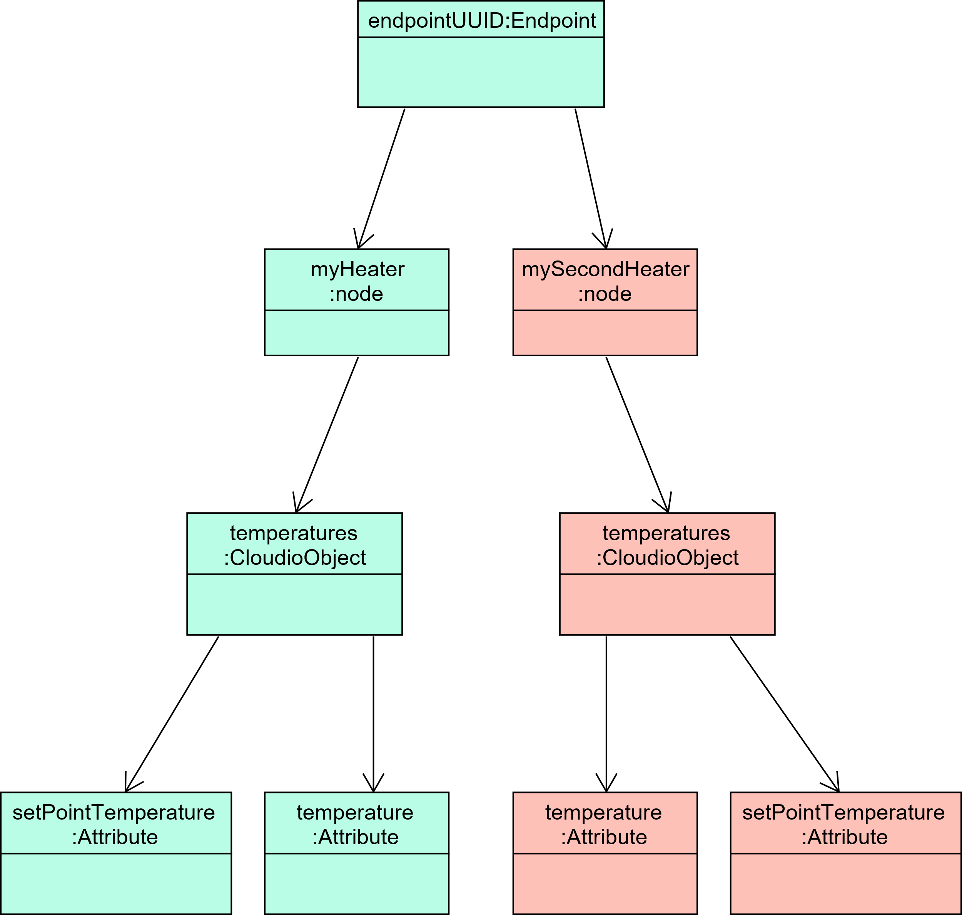
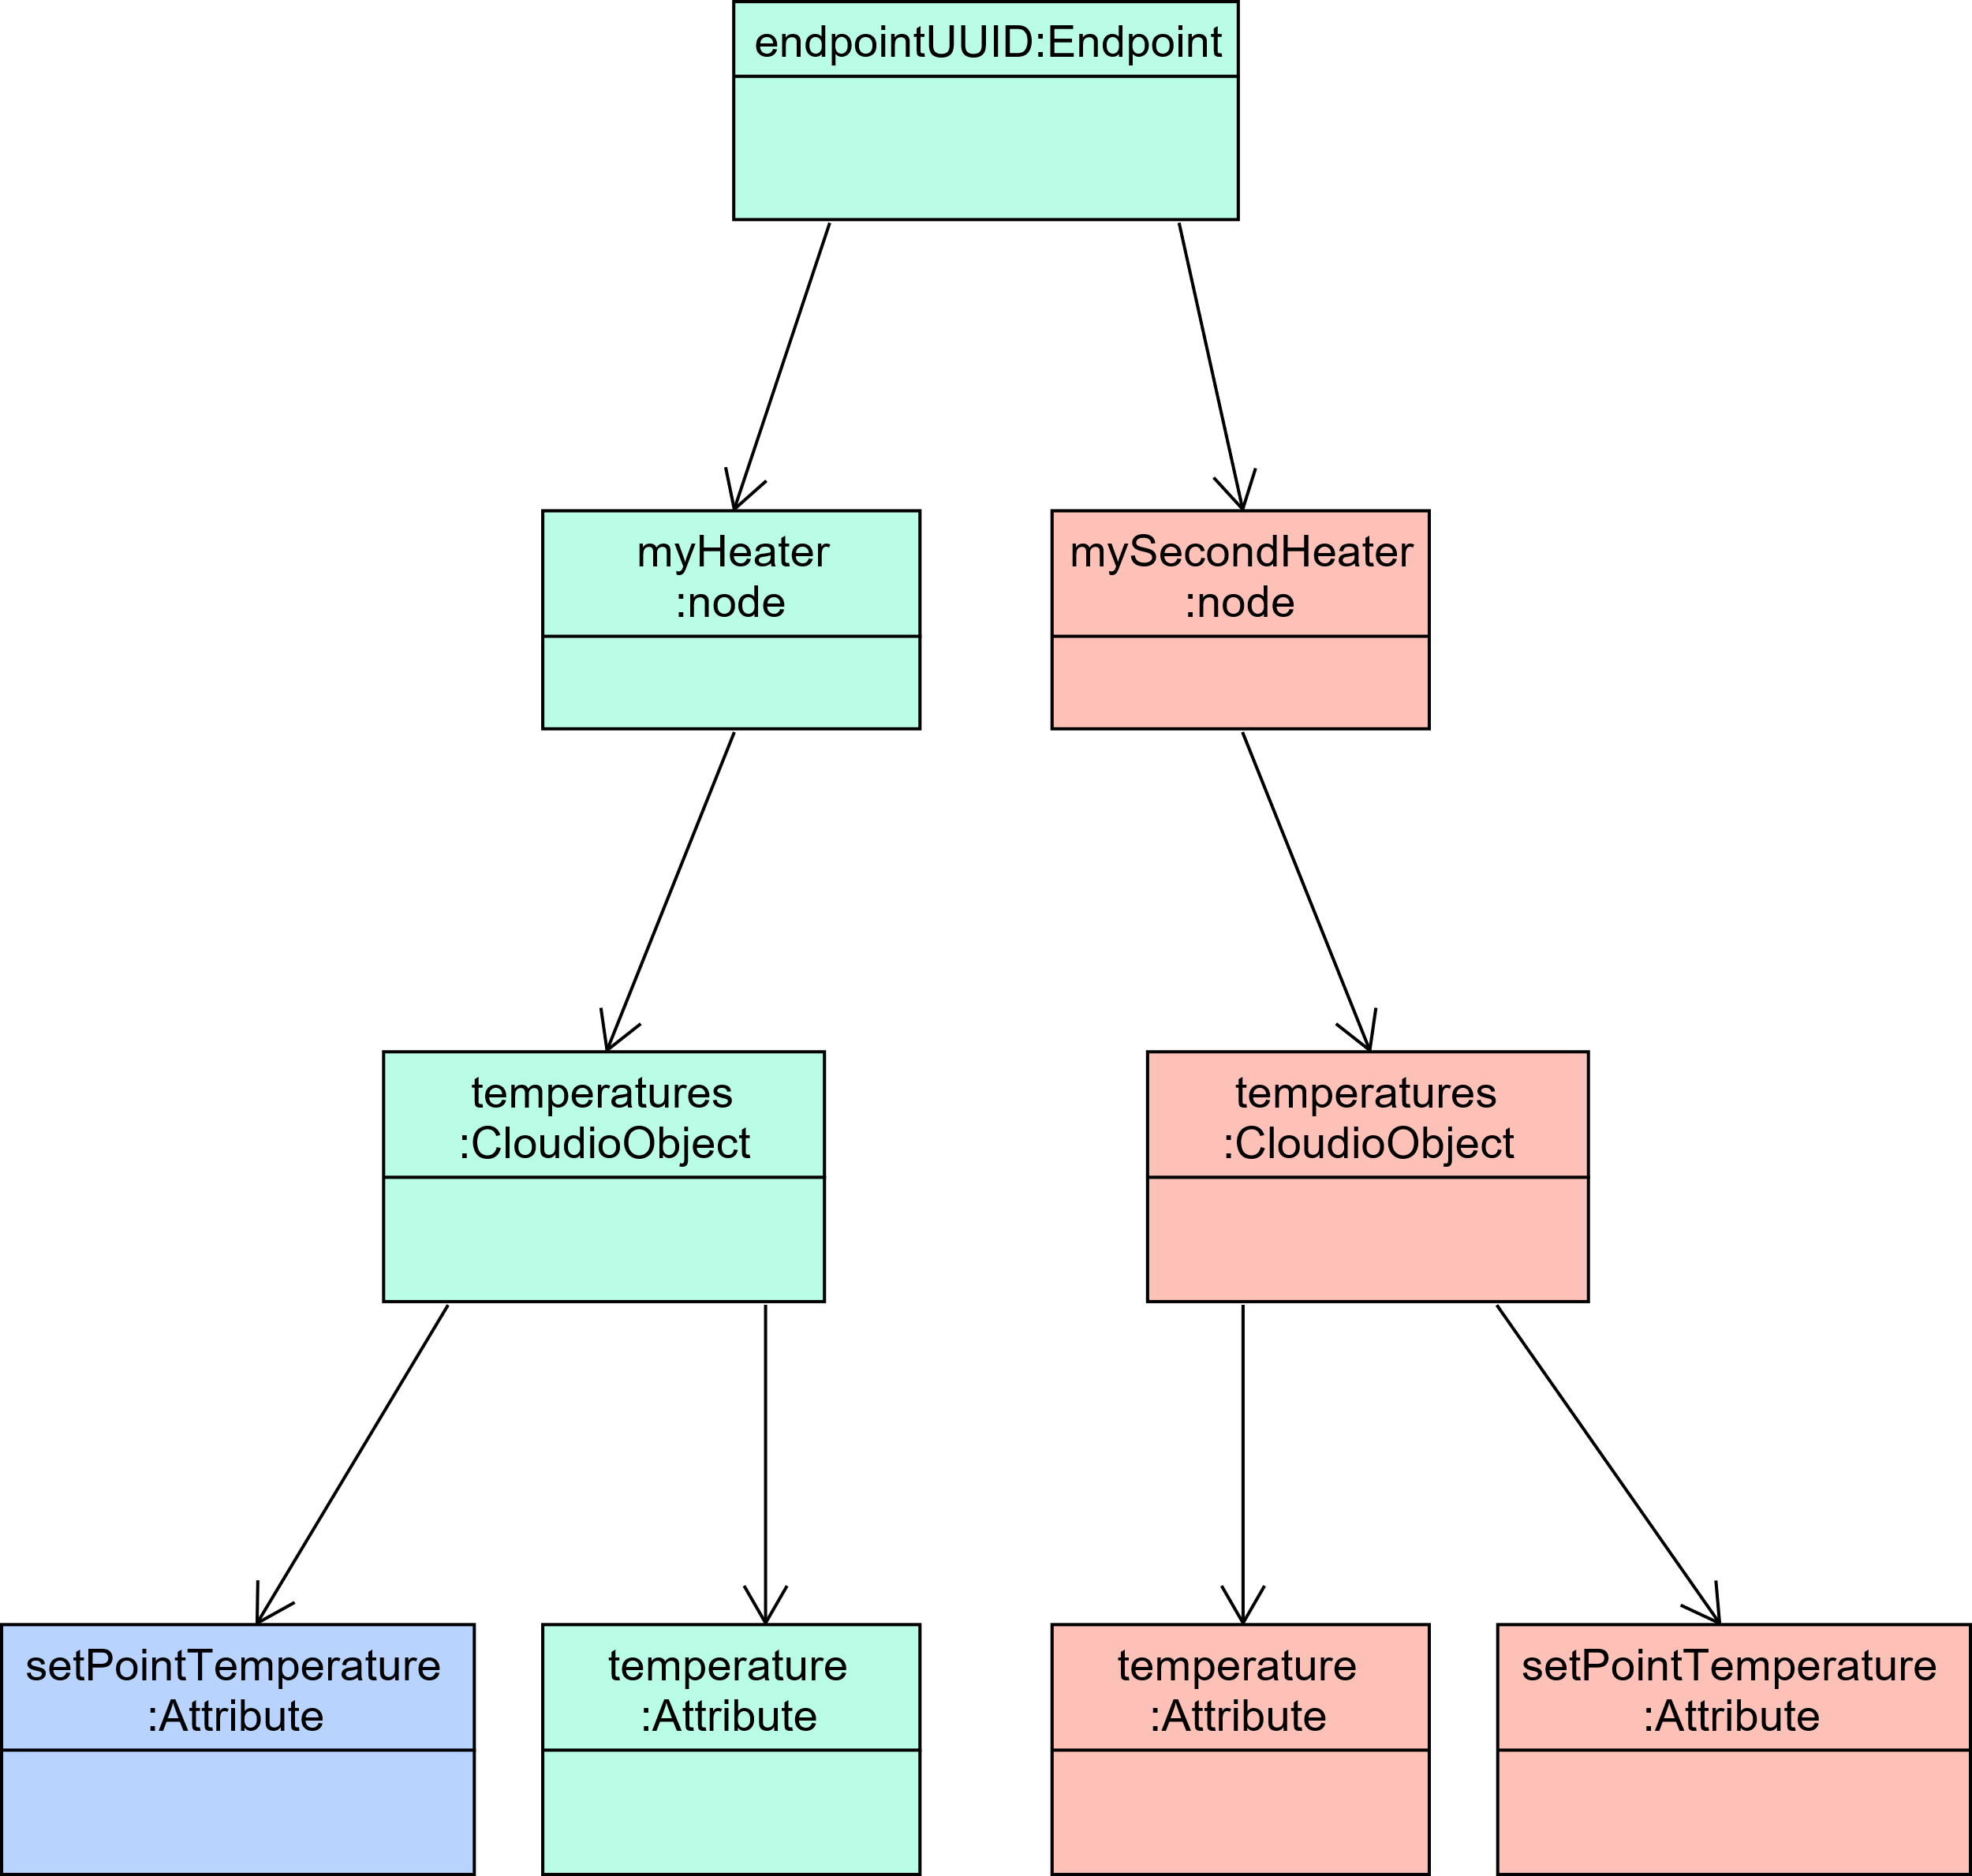
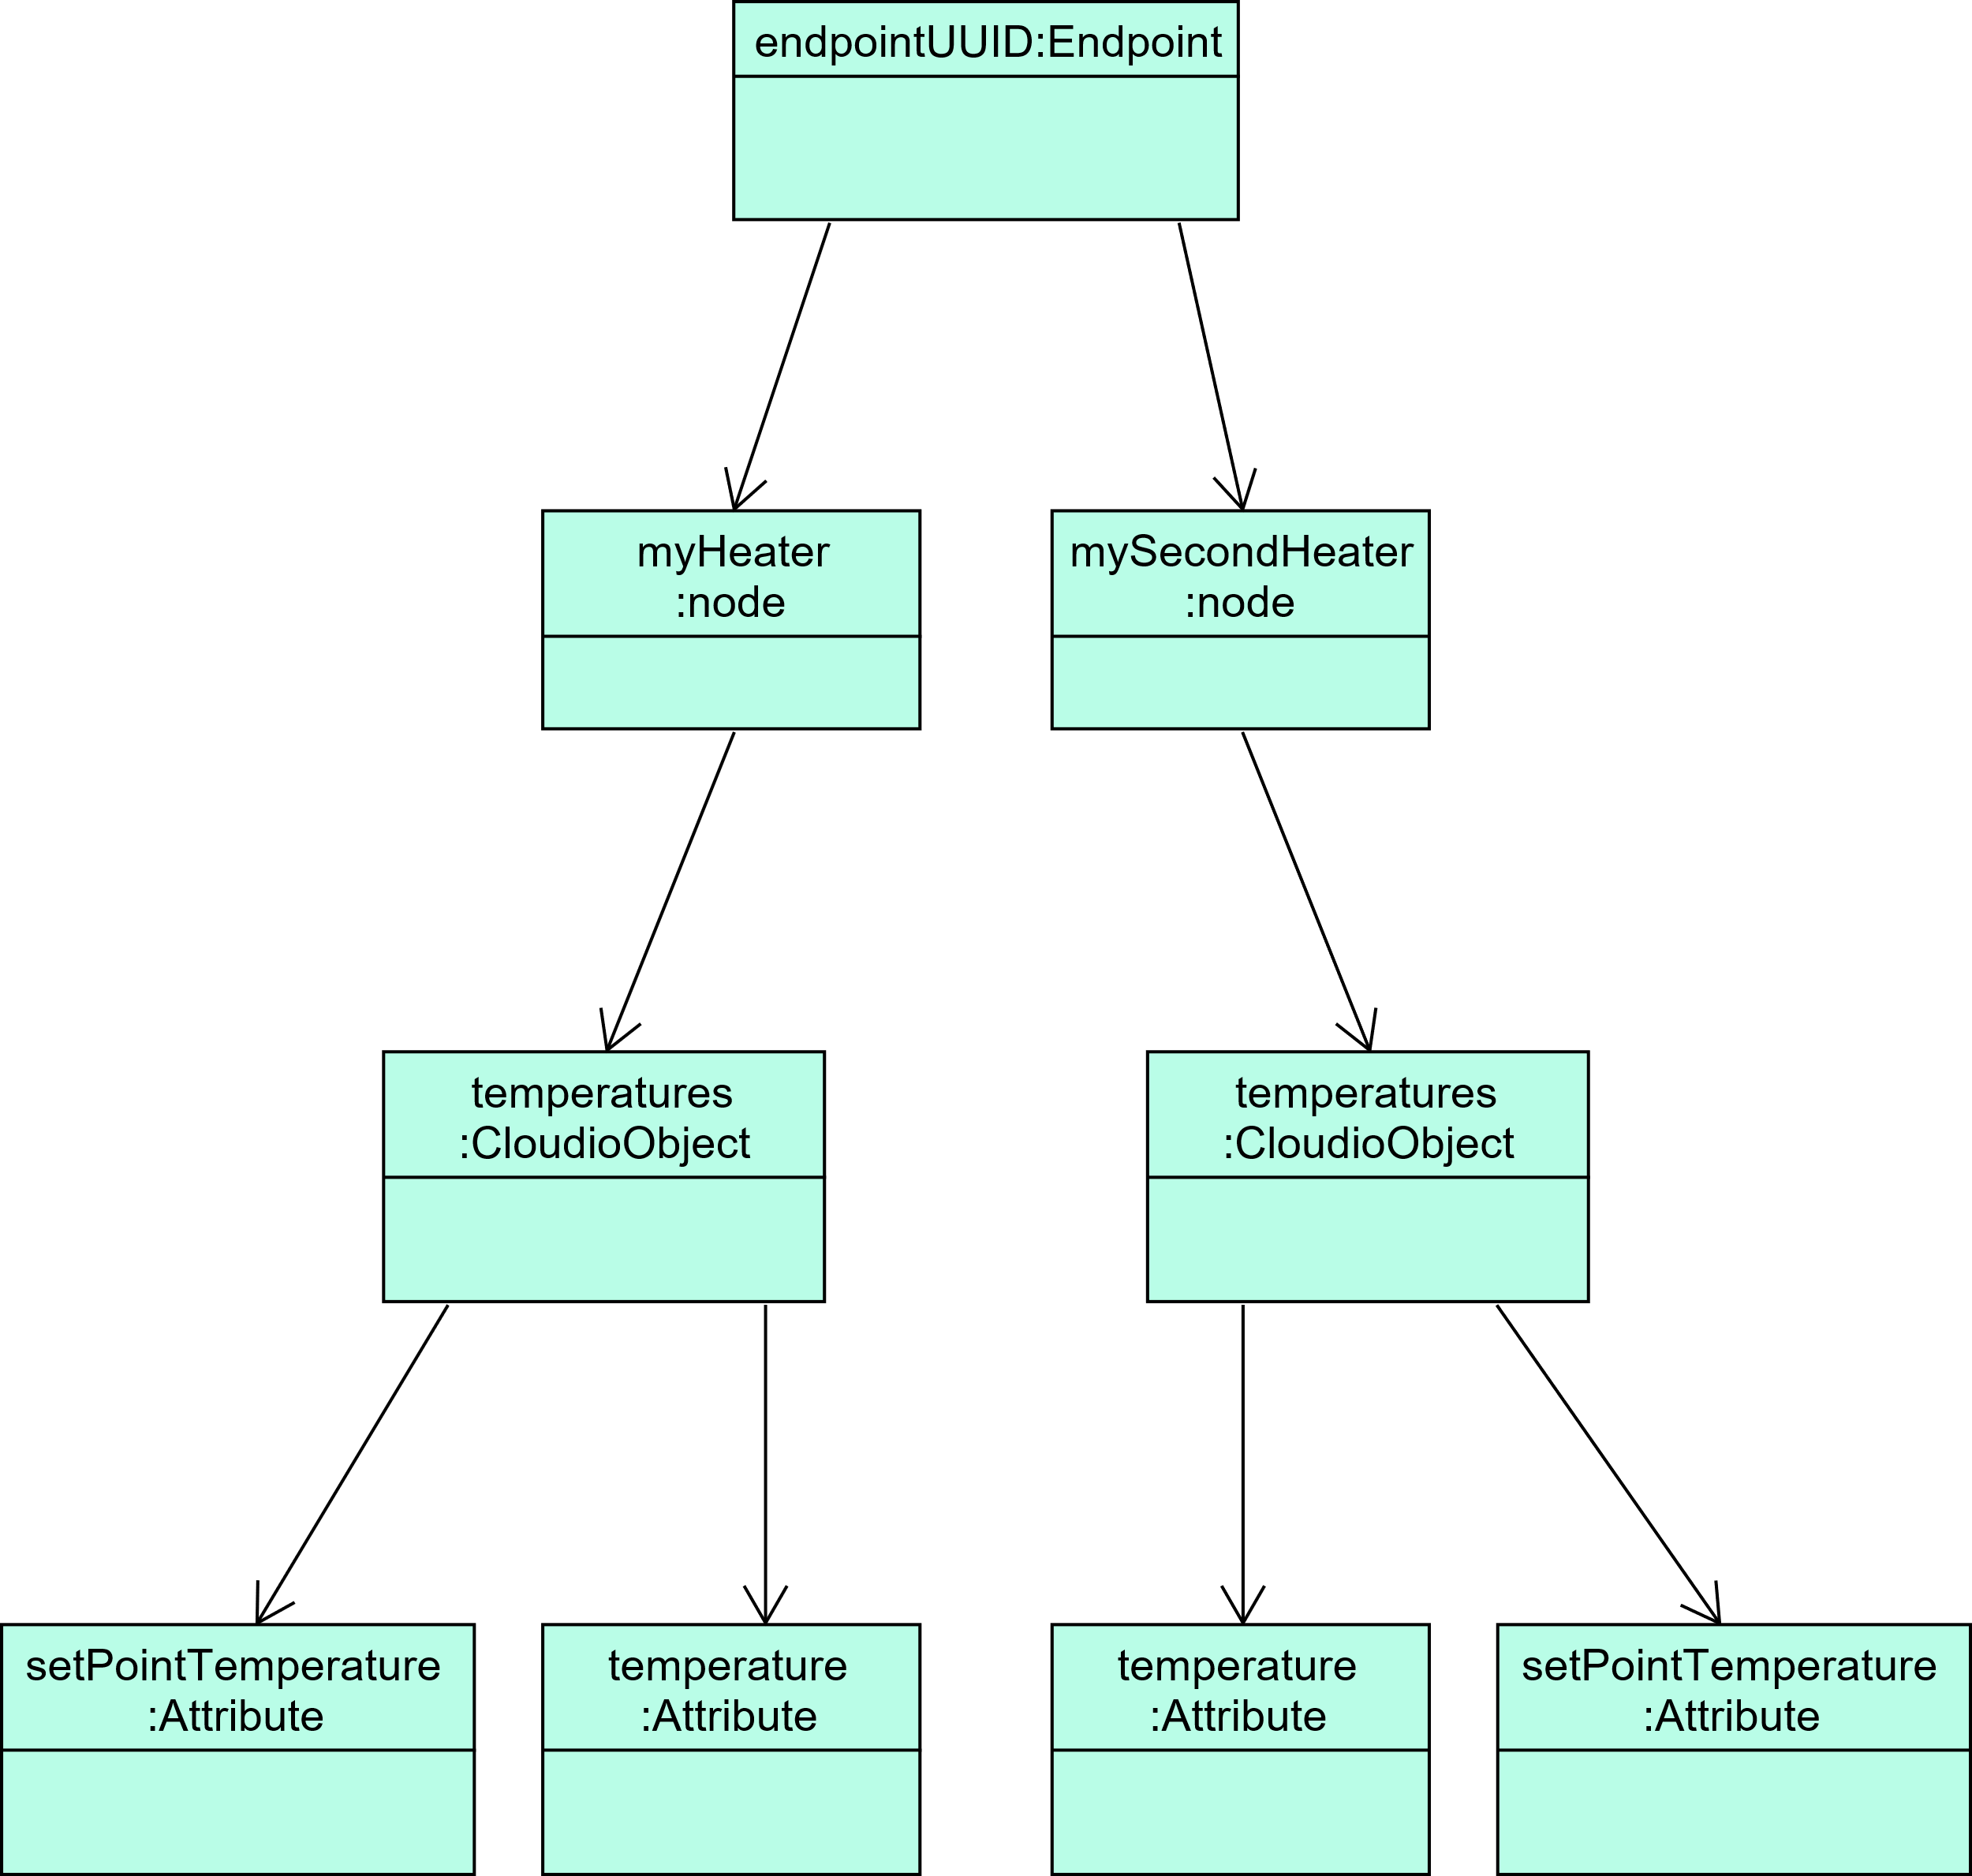
Conception: Topic & Access Control 2/2
{
" permissions ": {
" endpointUUID /#": {
"permission": "WRITE",
"priority": "LOW"
},
"endpointUUID/mySecondHeater/#": {
"permission": "DENY",
"priority": "HIGH"
},
"endpointUUID/myHeater/temperatures
↳/setPointTemperature ": {
"permission": "READ",
"priority": "HIGHEST"
}
}
}

Slide 27
Conception: Remote Job Execution
Remote Jobs Execution
Execute Shell script remotely
Possibility to retrieve output of script
Pre-implemented command
Listing all available commands/scripts
Update Scripts from an URL
Topic: @exec/ bc0f1bf8-bdae-11e9-9cb5-2a2ae2dbcce4
{
"jobURI": "cmd://listJobs",
"correlationID": "1a45a6ca",
"data": "",
"sendOutput": true
}
Topic: @execOutput/ bc0f1bf8-bdae-11e9-9cb5-2a2ae2dbcce4
{
"data": "This is a Job output",
"correlationID": "1a45a6ca"
}

Slide 28
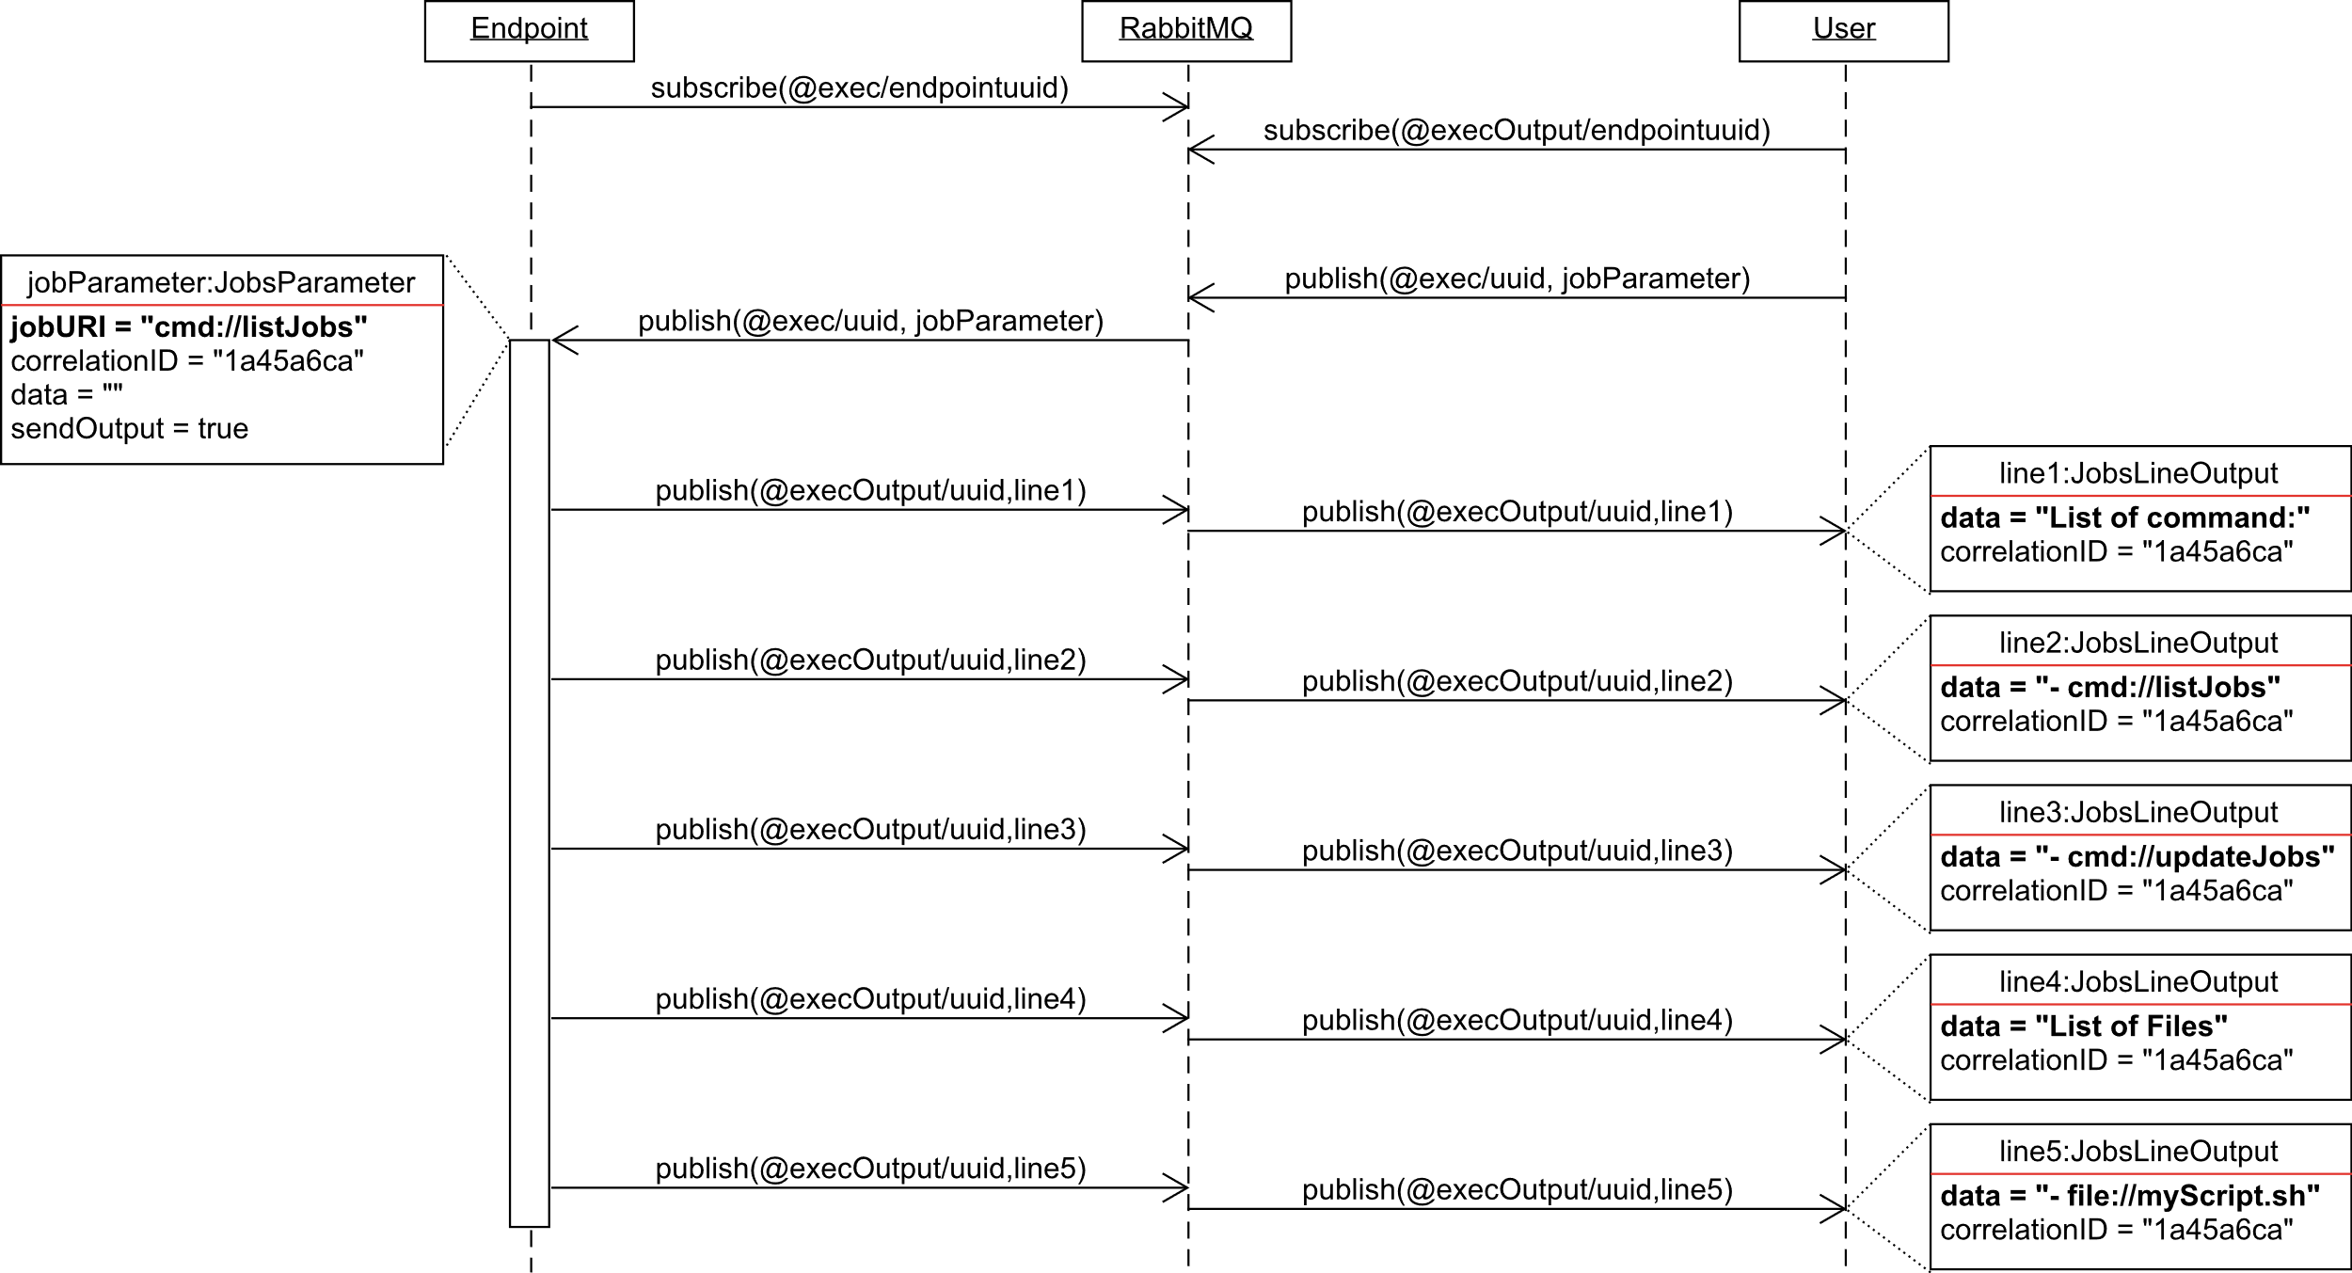
Conception: Remote Job Execution

Slide 29
Conception: Logging
Logging
Saved as time-series
Possibility to filter by log level
Retrieve through RESTful API
User Log4j
Different log level
OFF
FATAL
ERROR
WARN
Topic: @logs/ bc0f1bf8-bdae-11e9-9cb5-2a2ae2dbcce4
{
"level": "ERROR",
"timestamp": 1577802897012,
"message": "Data Error",
"loggerName": "HeaterLogger",
"logSource": "Heater/main, line 27"
}
INFO
DEBUG
TRACE
ALL
Topic: @logsLevel/ bc0f1bf8-bdae-11e9-9cb5-2a2ae2dbcce4
{
"level": "TRACE"
}

Slide 30
Conception: Transaction
Topic: @transaction/ bc0f1bf8-bdae-11e9-9cb5-2a2ae2dbcce4
{
"attributes": {
"endpointUUID/…/exampleAttribute1": {
"constraint": "Measure",
"timestamp": 1577802897520,
"type": "Number",
"value": 25.1
},
"endpointUUID/…/exampleAttribute2": {
"constraint": "Measure",
"timestamp": 1577802897750,
"type": "Number",
"value": 23.1
},
"endpointUUID/…/exampleAttribute3": {
"constraint": "Status",
"timestamp": 1577802898290,
"type": "String",
"value": "Example"
}
}
}
Problematic:
cloud.iO v0.1 Can only update one attribute at a time
Solution:
Transaction
beginTransaction()
commitTransaction()
rollbackTransaction()

Slide 31
Conception: Certificate Management
In cloud.iO v0.1: Manually by an administrator
In cloud.iO V0.2: Generated by the cloud, available through RESTful API
Generating certificate and private key
Generating certificate from public key
Generating Zip files with certificates and config file for SDK

Slide 32
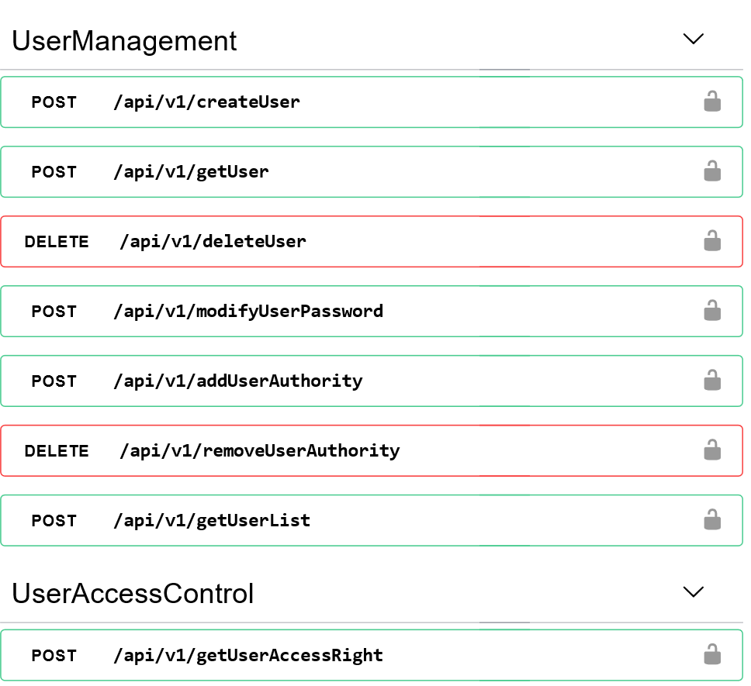
Conception: RESTful API
Http tools
User authentication
Support Https
Tools for User and Administrator
User & User Group Management
Endpoint Management
Certificate
History
Logging
Remote Jobs Execution
…

Slide 33
Conception: RESTful API, multiple challenges
Problematics | Solutions
Authentication | Use of access control database, custom User Details Service
Retrieving certificates | Sending files, custom Response Entity
Getting notified of attribute change | Longpoll
Re-create the Remote Jobs execution messages sequence | Server-sent events

Slide 34


Conception: Web Of Things Compliance 1/2
Thing
WoT Servient
Interact
Expose
TD Consumer
Consume
Application
WoT Servient

Slide 35
Conception: Web Of Things Compliance 2/2
{
"@context": "https://www.w3.org/2019/wot/td/v1",
"id": "urn:bc0f1bf8-bdae-11e9-9cb5-2a2ae2dbcce4:myHeater",
"title": "myHeater",
"securityDefinitions": {
"https_sc": {
"scheme": "basic",
"in": "query"
},
"mqtts_sc": {"scheme": "cert"}
},
"security": [
"https_sc",
"mqtts_sc"
],
"properties": {
"endpointUUID.myHeater.temperatures.setPointTemperature": {
...
},
"events": {
"endpointUUID.myHeater.temperatures.setPointTemperature": {
...
}
}

Slide 36
Conception: Web Of Things Compliance 2/2
"properties": {
"endpointUUID.myHeater.temperatures.setPointTemperature": {
"type": "object",
"properties": {
"constraint": {"type": "string", "enum": ["SetPoint"]},
"type": {"type": "string", "enum": ["Integer"]},
"timestamp": {"type": "number"},
"value": {"type": "number"}
},
"required": ["constraint","type","timestamp","value"],
"forms": [
{
"href": "https://cloud.iO:8081/api/v1/getAttribute/endpointUUID.…",
"op": "readproperty",
"contentType": "application/json"
},
{
"href": "mqtts://cloud.iO:8883/@set/endpointUUID/…",
"op": "writeproperty",
"contentType": "application/json“
},
{
"href": "https://cloud.iO:8081/api/v1/setAttribute/endpointUUID.…",
"op": "writeproperty",
"contentType": "application/json"
}
},
"events": {
"endpointUUID.myHeater.temperatures.setPointTemperature": {
...
}
}
Notes:
Même type de structure pour event

Slide 37
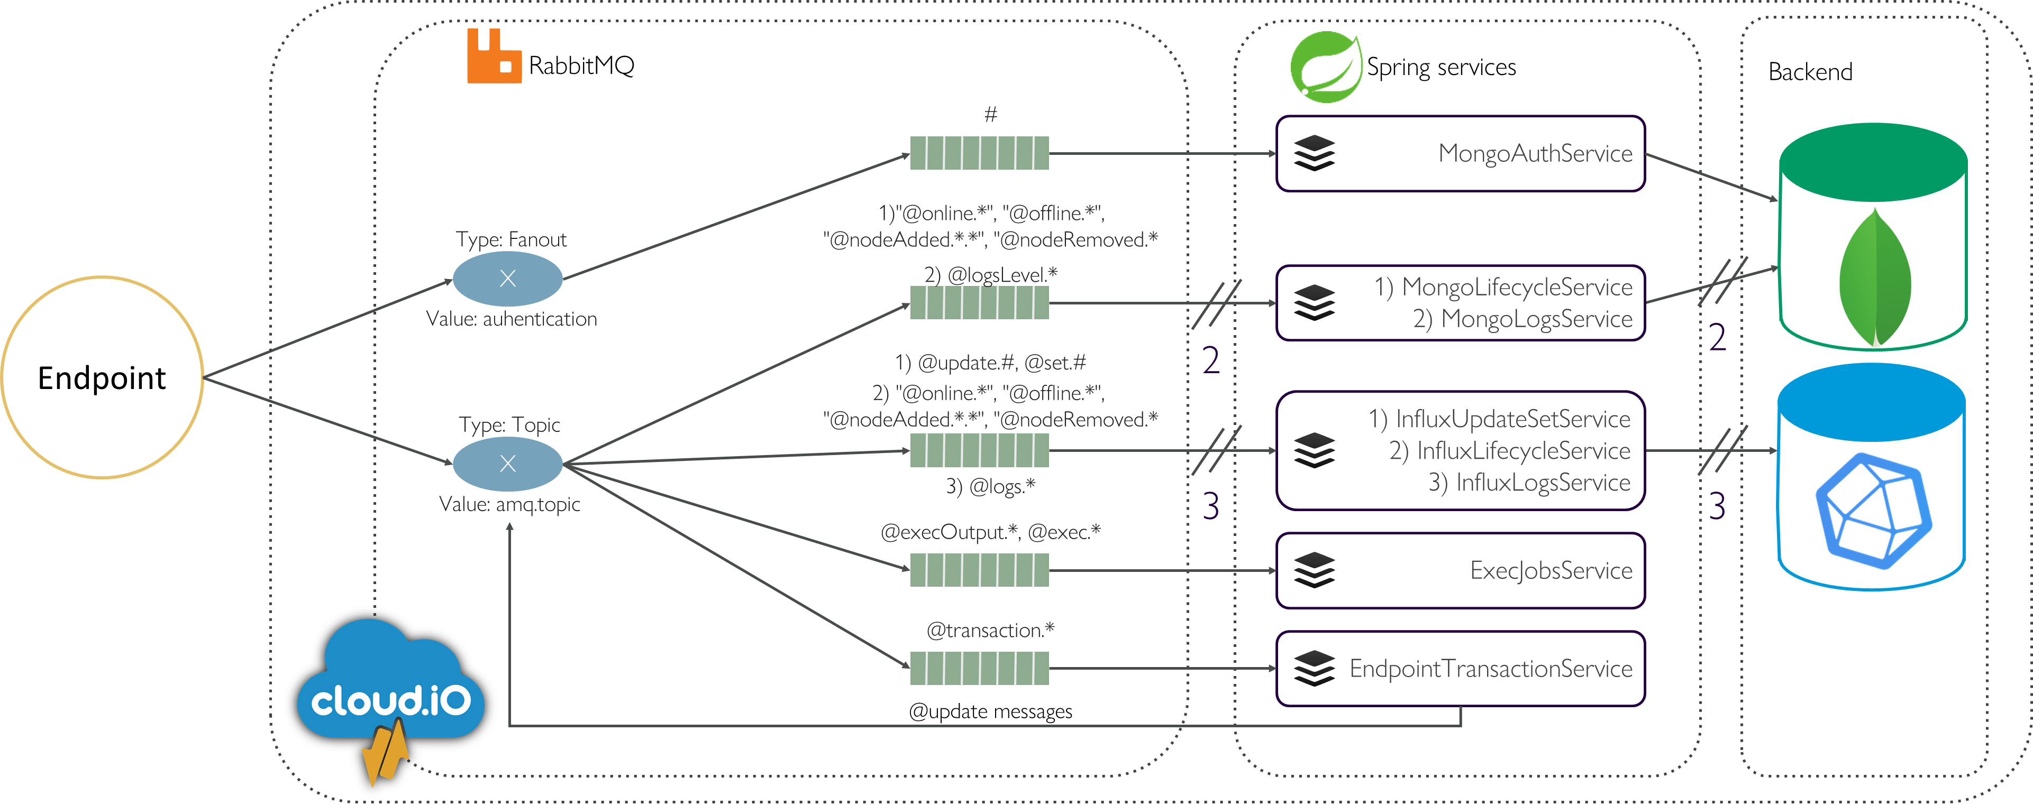
Conception: cloud.iO v0.2 architecture, messaging

Slide 38
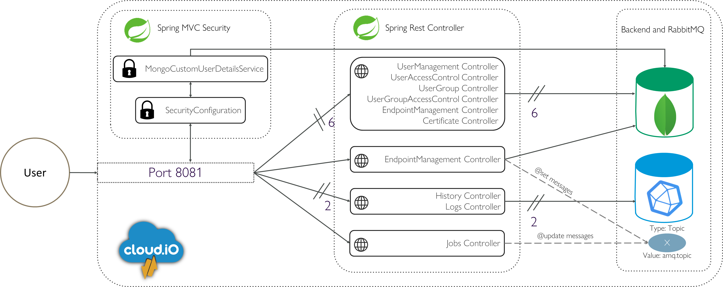
Conception: cloud.iO v0.2 architecture, RESTful API

Slide 39
Tests and Results: Web of Thing TD Evaluation
JSON validation
WoT recommendation validation
JSON validation with with JSON Schema
JSON-LD validation

Slide 40
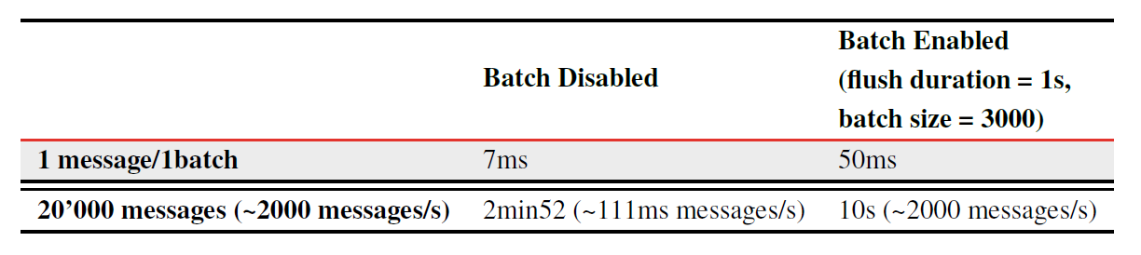
Tests and Results: Performances Evaluation 1/2
Database linked service
Use of Batch for InfluxDB

Slide 41
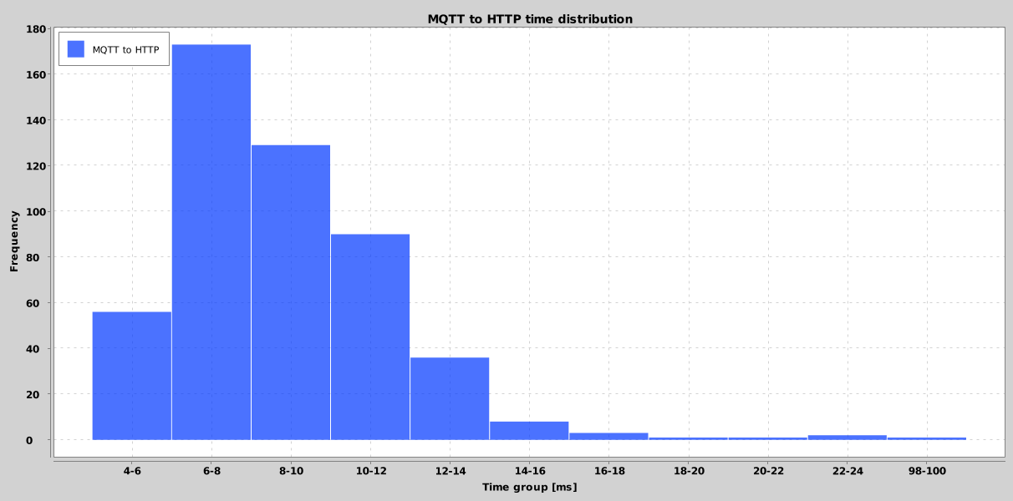
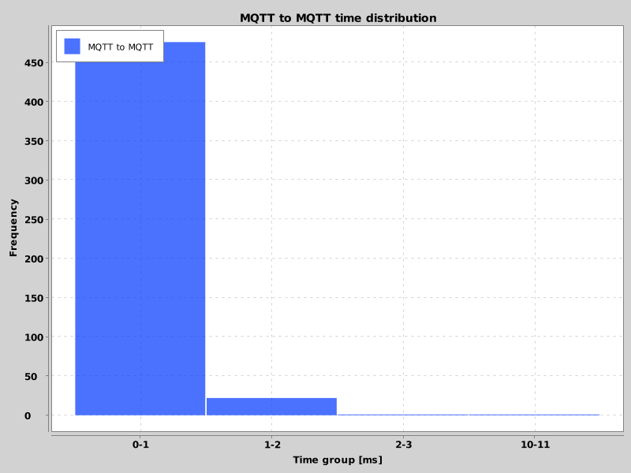
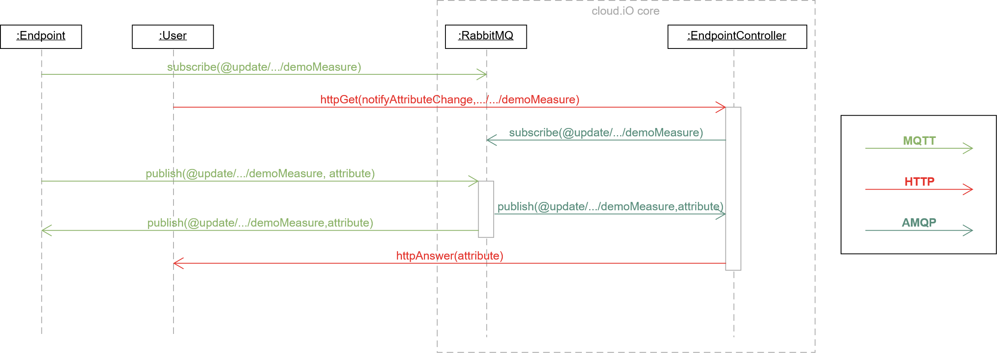
Tests and Results: Performances Evaluation 2/2
Use case: send mqtt message, retrieve it with mqtt and http

Slide 42
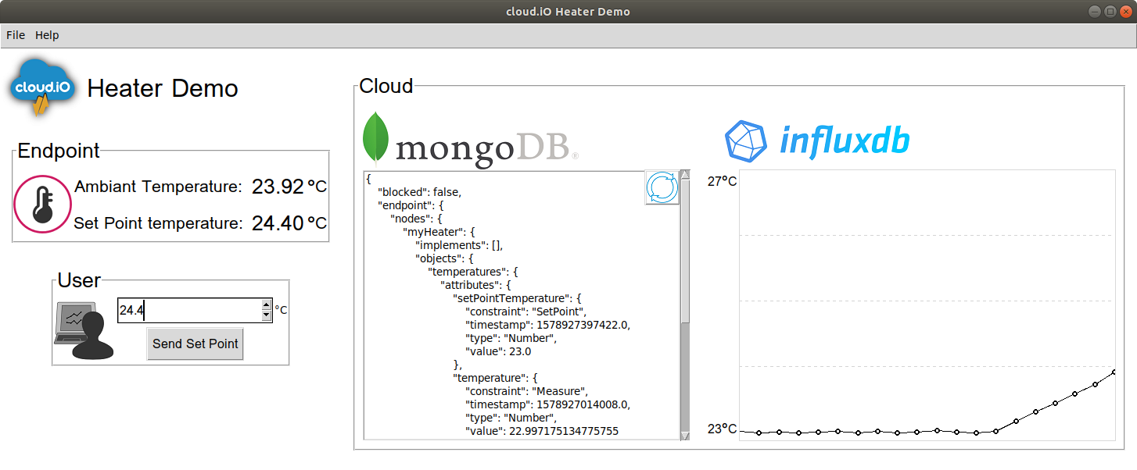
Tests and Results: Evaluation the API and demonstrator
Evaluation of API
Test during implementation with http client (Insomnia)
55 unit tests with 140 use cases
Demonstrator

Slide 43
Conclusion: Project Overview
Specification for cloud.iO established
Implemented and tested functionality
Lack of tests with a deployed version of cloud.iO v0.2
Redefine topic & access control
Logging
Transaction
Certificate creation
Remote Job Execution
API (RESTful)
Interoperability
log
Notes:
On a fait un papier!

Slide 44
Conclusion: Future Improvement
Authentication using JSON Web Token (JWT) [6]
Continuous work on W3C WoT
Other web technologies (WebSocket, MQTT over WebSocket, …)
More languages support for Endpoint Library

Slide 45
Questions?

Slide 46
References
[1] IDC, “The Growth in Connected IoT Devices Is Expected to Generate 79.4ZB of Data in 2025, According to a New IDC Forecast,” 2019, https://www.idc.com/getdoc.jsp?containerId=prUS45213219.
[2] Cisco and/or its affiliates, “Cisco Global Cloud Index: Forecast and Methodology, 2016–2021,” 2018.
[3] P. Roduit, D. Gabioud, G. Basso, G. Maitre, and P. Ferrez, “cloud.io: A decentralised iot architecture to control electrical appliances in households,” in Smart Cities, Green Technologies and Intelligent Transport Systems,
B. Donnellan, C. Klein, M. Helfert, and O. Gusikhin, Eds. Cham: Springer International Publishing, 2019, pp. 67–89.
[4] M. Kovatsch, R. Matsukura, M. Lagally, T. Kawaguchi, K. Toumura, and K. Kajimoto, “Web of Things (WoT) Architecture,” 2019, https://www.w3.org/TR/wot-architecture/.
[5] S. Kaebisch, T. Kamiya, M. McCool, V. Charpenay, and M. Kovatsch, “Web of Things (WoT) Thing Description,” 2019, https://www.w3.org/TR/wot-thing-description/.
[6] JSON Web Token (JWT), Internet Engineering Task Force, 05 2015. [Online]. Available: https://tools.ietf.org/html/rfc7519

